Slide 1

CRITICAL THInking
VU HONG PHUC 20233584

Slide 2

What is critical Thinking?
Critical thinking refers to the ability to analyze information objectively and make a reasoned judgment. It involves the evaluation of sources, such as data, facts, observable phenomena, and research findings.
Simply, It’s thinking about what you are thinking

Slide 3
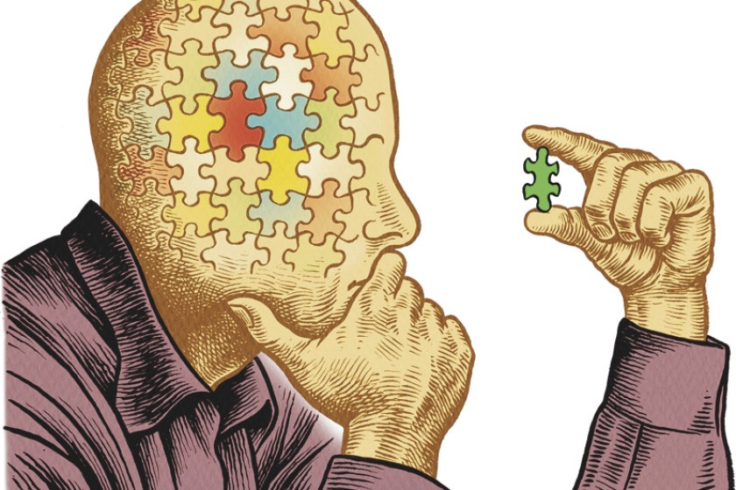
EXample
A triage nurse analyzes the cases at hand and decides the order by which the patients should be treated.
A plumber evaluates the materials that would best suit a particular job.
A manager analyzes customer feedback forms and uses this information to develop a customer service training session for employees.

Slide 4
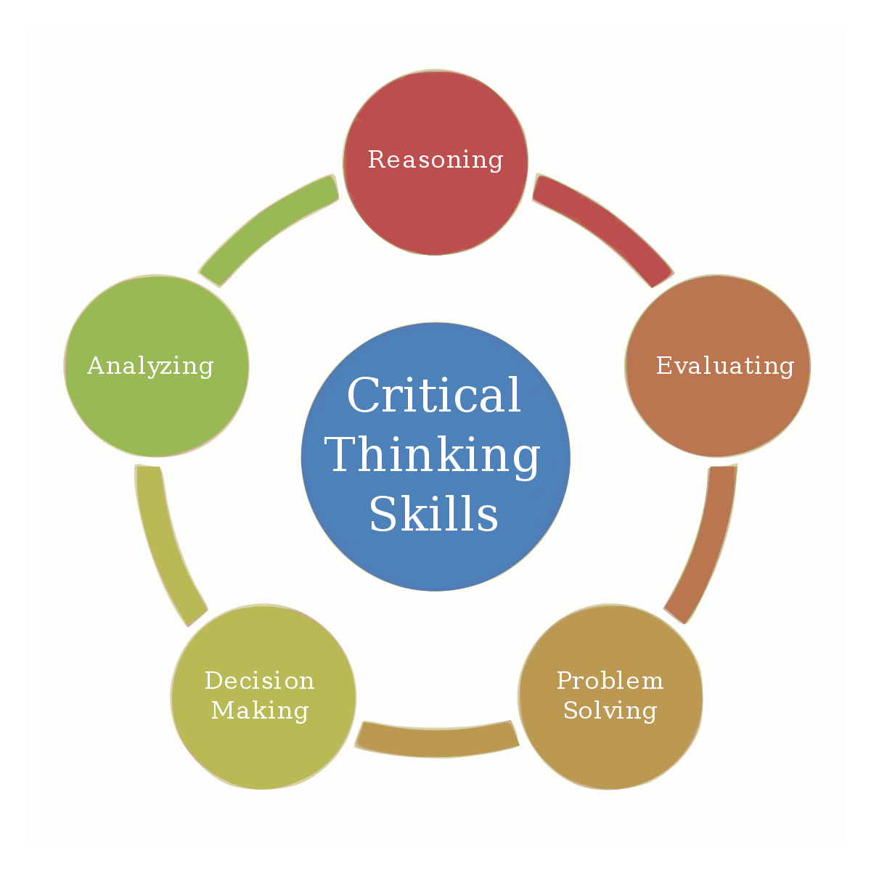
CRITICAL THINKING SKILLS

Slide 5

WHY IS CRITical thinking important
Critical Thinking Is Universal
Crucial For The Economy
Improves Language & Presentation Skills
Promotes Creativity
Important For Self-Reflection
The Basis Of Science & Democracy

Slide 6

HoW to develop IT
Don’t Believe Everything You’re Told
Don’t Believe Everything You Think
Research Deeper Ask Questions Evaluate Your Work

Slide 7


Thank you

